Slide 1

HealthCare
Dataset Handling
in Pyspark
Steps by step guide to handle health care data with Pyspark in Databricks. Create Graphs and complex transformations to make data-driven approach to answer our questions, analyze and make a proper flow of treatment based on patient’s age, blood type and even gender

Slide 2

Problem Statement
In healthcare management, identifying underlying disease patterns, cost-effectiveness are essential.
However, challenges arise in maintaining patient profiles, medical conditions, and blood type. Such as-
Patients withs similar Blood Group in case of emergency
Patients profile with details like Last Doctor, medication, blood group etc.
Search the name of the patient from database
Most common Medical Condition
Which ages are effected the most?
Diabetes effect which blood type most?
Effect of Medical Condition based on gender?
Our goal is to leverage data-driven approaches to address these challenges and enhance the quality and efficiency of healthcare services.

Slide 3
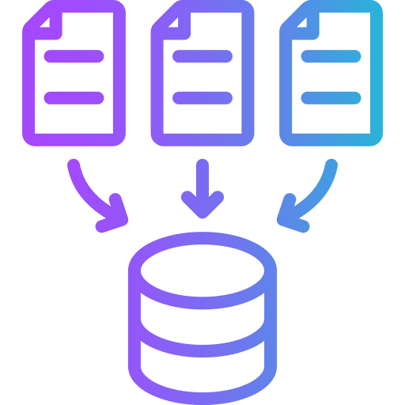




Workflow of the Project
Data Collection
Data Import
Data Cleaning
Data Analysis
Data Dashboard

Slide 4



Tools for the Project

Slide 5
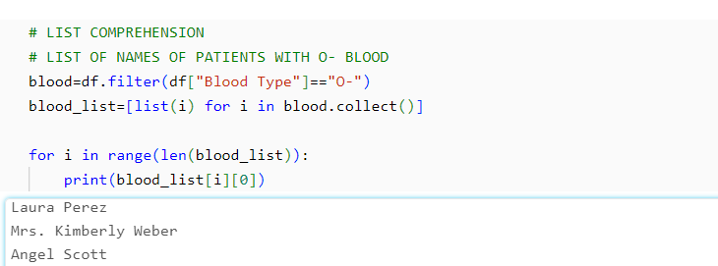
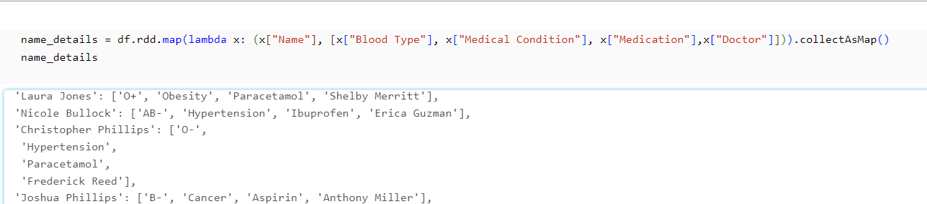
Analysis Report
Patients withs similar Blood Group in case of emergency
Patients profile with details like Last Doctor, medication, blood group etc.

Slide 6
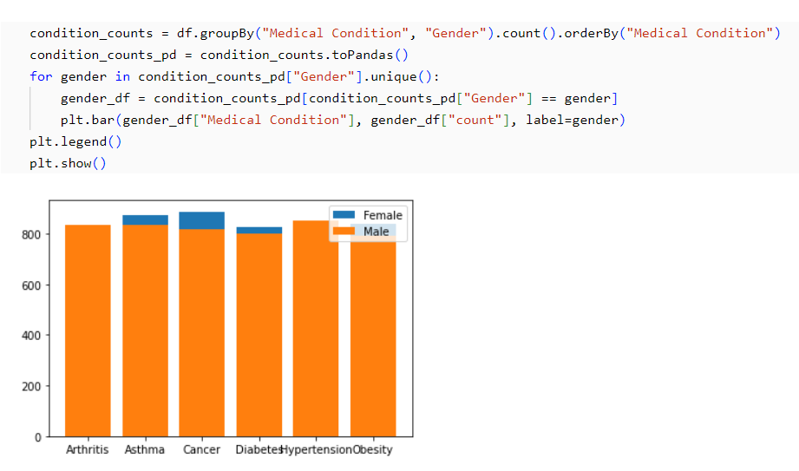
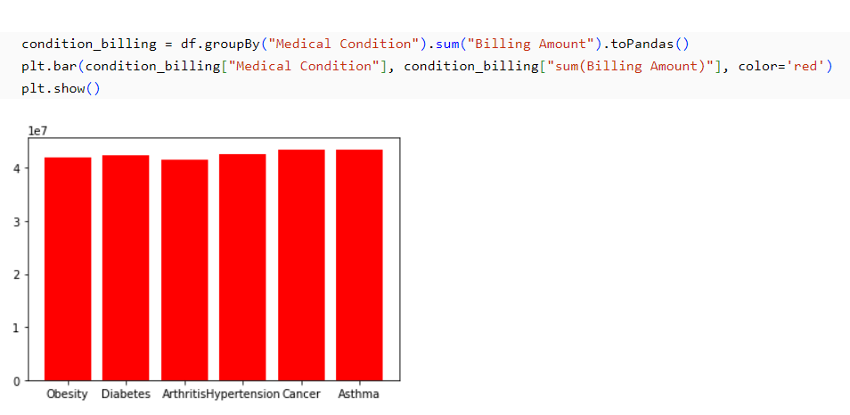
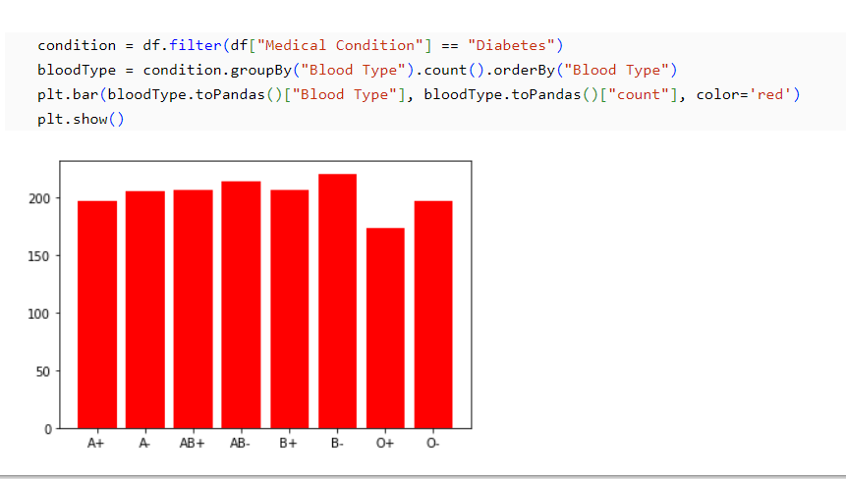
1
2
3

Slide 7

Conclusion
1
With this analysis project we can create a
Patient Profile database.
2
Run Query on the database to retrieve information like
Which patients have similar blood type in emergency.
3
Information like which blood type and age is most
vulnerable to a condition can be analyzed.
4
Difference in male and female count for a particular
disease and treat them based on body type.

